Slide 1
RESIDENTS’ SURVEY RESULTS, POLICE REVIEW, CAP INDEX ANALYSIS AND COMMITTEE RECOMMENDATIONS
Abbottsford Security Committee Members
Cody Carroll
K.C. Delfino
Margaret Levine
Gerald Nicely
Breck Walker
Chris Wells
October 18, 2023

Slide 2
SECURITY SURVEY
of
Abbottsford’s Residents
June 2023

Slide 3
Survey Highlights
69 residents responded to the survey.
Not everyone answered all the questions.
The question regarding comfort / discomfort with the security environment received the most responses (68).
Access Control as a security priority received the fewest responses (61).
Most questions / options received 66 responses.
Respondents are comfortable or very comfortable with the security environment.
Access Control and Incident Tracking are the top two potential security enhancements supported by survey respondents.
Crimes Against Persons and Crimes Against Property ranked as the top two concerns of survey respondents.
Specific topics receiving the most comments are Gates, Information-Sharing, Homeowner Responsibility and the Security Environment.
General comments address the security environment and neighborhood hazards.

Slide 4
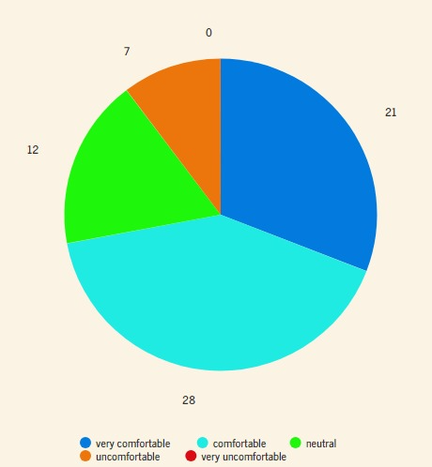
Q1: Rate your level of comfort with Abbottsford’s general security environment.
68 responses were received.
The overwhelming majority – 49 (72%) – are either comfortable (28 residents – 41%) or very comfortable (21 residents – 31%).
7 residents (10%) are uncomfortable.
12 residents (18%) are neutral.*
No residents reported being very uncomfortable.
* One resident commented, “I responded ‘neutral’ to my comfort with the security environment, but it’s probably better stated as neutral trending toward uncomfortable.”

Slide 5
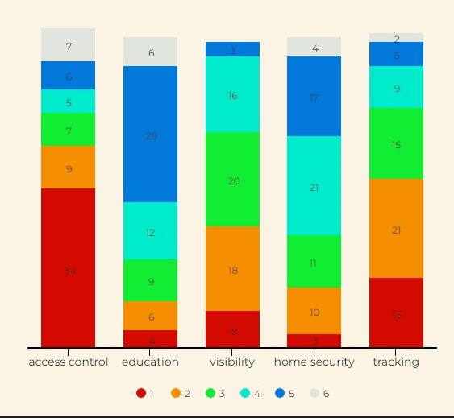
Q2: What are your priorities for ensuring Abbottsford’s security? Please assign a sequential number to each option, with 1 being your top priority and 6 being your lowest priority.*
Not all residents gave a ranking to every option. A breakdown by option shows: Access Control (61), Education (66), Visibility (65), Home Security (66), and Tracking (65).
ACCESS CONTROL is the top priority of more than half the respondents for ensuring neighborhood security: 34 of 61 respondents (56%). Nine respondents ranked Access Control second. Note that this option is an outlier in terms of the number of respondents overall who ranked it and it received the greatest number of “other” ratings – 7 (11%) gave it a ranking of 6.
TRACKING ranks second, with 36 of 65 respondents (55%) rating it their top (15) or second (21) priority.
VISIBILITY ranks third, with 26 of 65 respondents (43%) rating it their top (8) or second (18) priority.
EDUCATION and HOME SECURITY ranked at the bottom of the priorities, possibly indicating that residents think they’re already doing enough or that residents aren’t embracing personal ownership.
* A rating of 6 (“other”) provided an opportunity for respondents to provide a different priority.
Although some priorities received rankings of 6, no one provided any suggestions.

Slide 6
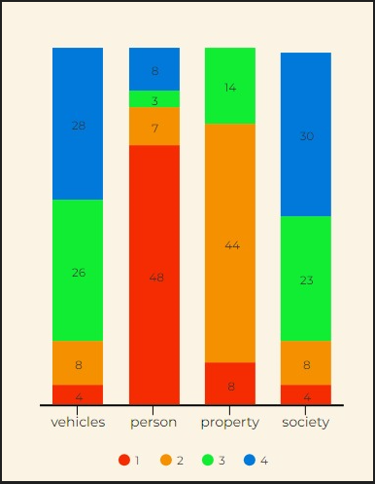
Q3: Please number in sequential order the categories of crime – Motor Vehicle Crimes, Crimes Against Persons, Against Property, Against Society – from greatest to least concern to you. Assign 1 to the category of greatest concern and 4 to the category of least concern.
CRIMES AGAINST PERSONS (eg., murder, assault, robbery, stalking, sexual assault, kidnapping) is the greatest concern of survey respondents, with 48 out of 66 respondents (73%) ranking it #1. Only 7 respondents (11%) ranked Crimes Against Persons as their second concern.
CRIMES AGAINST PROPERTY (eg., burglary, vandalism/destruction of property, larceny/theft, arson) was close behind, with 44 out of 66 respondents (67%) ranking it their second concern. Only 8 (12%) ranked Crimes Against Property as their greatest concern.
MOTOR VEHICLE CRIMES and CRIMES AGAINST SOCIETY* fell substantially below Crimes Against Persons and Crimes Against Property in terms of respondents’ concerns and are virtually even in their 3rd place and 4th place rankings.
* One respondent did not rate Crimes Against Society, noting that s/he didn’t understand the meaning of the term.

Slide 7
Summary of Residents’ Comments
29 residents provided comments. Some comments addressed more than one topic.
Gates: 5 Pro. 4 Con.
Gate with a guard. (3)
We have been down this road before. No gates. (2)
Entrance is too accessible.
7:00 a.m. to 7:00 p.m. card reader access; 7:00 p.m. to 7:00 a.m. manned gatekeeper.
Too many issues with security gates and legitimate contractors/deliveries.
Frequent malfunctions are the norm with even the best gates; so a guard is needed, too.
Very few folks want the hassle of dealing with the gate daily.
I am not worried about crime and oppose to any attempt to make Abbottsford a gated community.
Security Guard at Entry (does not include the gate/guard combo): 1 Pro. 2 Con.
I hope this is not a push to have some type of rent-a-cop.
Keep Us Informed of Actual Crimes in the Neighborhood.
Homeowners want to know exactly what kind of criminal activity has actually occurred in Abbottsford.
Transparency from the start could be helpful in keeping homeowners calm and better informed about our community’s security.
I’d encourage us to share notices of any problems so we have a good understanding of the level of concern we should / shouldn’t have.
I’m curious to know how many crimes have been committed in Abbottsford. How many break-ins (vehicle or homes) in the past 10 years? How many incidents of crime has Abbottsford experienced and when? In other words, what is the true vs perceived crime problem in Abbottsford.

Slide 8
Summary of Residents’ Comments (cont)
Homeowner Responsibility
Have more neighbors light their alleys and front doors.
We had a police officer advise us that some alleys are too dark.
Each residence needs to take care of its own security with a security system. Each resident needs to protect his/her own property.
We should stress that security is the individual homeowner’s responsibility. The role of the HOA should be to assist the homeowner in that regard.
Solicitors coming into neighborhoods is a nationwide problem. It can easily be solved by simply not opening your door to strangers.
We should continue to look out for each other and let our neighbors and Cody know when we will be out-of-town.
Security Environment
I have not had a problem with crime in the neighborhood; however, many neighbors seem to be concerned.
We are new to the neighborhood and I feel very safe here.
We feel very safe in the Abbottsford neighborhood.
As long as there are lots of dog walkers, workers of all sorts, Cody, etc. I don’t worry too much.
Abbottsford should take a crime prevention position. Let’s not have murder or rape be the cause of Abbottsford taking-up crime prevention.
More than anything, we would not like to see Abbottsford react with fear when we have experienced or heard of only a couple of events, not even ones in our own complex.
Over the past few years, we’ve had a few solicitors come door-to-door, usually in the evening. No one is on-site to call and I’m never sure what the best alternative is except the police. I don’t have a fix, but I recommend we not allow non-residents to walk in Abbottsford if possible.
General Comments
My biggest fear in this neighborhood is getting hit by a car, whether driven by a neighbor, vendor, or contractor.
Too many residents park outside their garages, including on the main streets. This practice disturbs the appearance of our community at times can present a driving hazard.
I appreciate having Cody around. He is always quick to respond.

Slide 9
POLICE REVIEW
of
Abbottsford’s Security Environment
September 28-29, 2023

Slide 10
Highlights of Metro Nashville Police Review
On Thursday, Sept 27, Lt. Tommy Durbin of the West Precinct conducted a daytime survey of Abbottsford’s security environment. On Friday, September 28, Lt. Durbin conducted a nighttime survey.
A meeting was held with Lt. Durbin, Sergeant Matthew Valiquette, and Officer Torian Cox to review findings.
Lt. Durbin Summarized His Top Three Takeaways as:
Abbottsford is a safe community.
Be vigilant and call it in.
Communicate with one another.
Key Points of the Risk Assessment:
Crimes of opportunity are Abbottsford’s primary risk, including motor vehicle break-ins and thefts, and package thefts.
Crimes against persons would be very rare.
When crime happens at GH Mall, the criminals are not going to head toward Abbottsford. They’re going to go in the opposite direction because they’re looking to get out of the area. They don’t want to remain in the immediate vicinity.

Slide 11
Key Findings of Metro Nashville Police Review
CAMERAS
Adding cameras in common areas throughout the community is not a key concern. However, good cameras to read license plates and see people and vehicles coming in and out of the neighborhood are critical.
Abbottsford’s Flock License Plate Reader system and cameras mounted on the kiosk are crime prevention and investigation pluses.
Ring cameras on residences are helpful.
Would like to see Abbottsford tie-in its cameras (both Abbottsford and residential) to the police department’s Real Time Crime Center (RTCC). The HOA and each resident with a camera (Ring and/or other) can choose what to share and when to share it. Real-time camera footage is a valuable tool for police when responding to crime. Tie-in can be done as long as there is an internet connection. In addition to Nashville, both Knoxville and Memphis police departments have RTCCs.

Slide 12
Key Findings of Metro Nashville Police Review
FENCING
The wrought iron fences along Abbott Martin and Vailwood provide a good access control barrier and deter crime. They are difficult to climb over to enter or exit the neighborhood.
Chain link fences along other Abbottsford perimeters provide zero protection. They can easily and quickly be scaled to access or escape the neighborhood.
“Prickly shrubs” and/or “hostile hedges” are defensive plants that would boost security along vulnerable fence-lines.
Maintaining landscaping along all fence-lines is critical.
“No Trespassing” signage gives law enforcement a tool to remove suspicious persons from private property and can help support a conviction on a criminal trespass charge.

Slide 13
Key Findings of Metro Nashville Police Review
LIGHTING
Lighting in-and-around the community parking areas is lacking. These areas, like most of the community, are very dark and could be enticing to would-be thieves.
While residents may like the ambience and relaxed feeling of a dark neighborhood, the community should be aware that this is what will attract those wishing to commit crimes.
It would be easy for foliage to obscure lamp lighting. Routine monitoring and maintenance is essential to ensure that that lighting is not blocked.
In lamps, bulbs that emit the most / brightest light are ideal for safety and police response.
The alleys are dark; some are very dark. While improvement would be up to each individual homeowner, this should be encouraged.
Thick foliage along some of the alleyways provides good hiding places for criminals, and in some cases, may diminish lighting benefits coming from homes in adjacent neighborhoods.

Slide 14
CRIMECAST REPORT
CAP Index, Inc.
June 7, 2023

Slide 15
About the CAP Index Scoring System
The CAP Index Scoring System uses forecasting techniques that combine demographic and business statistics with crime and loss data to calculate crime risk.
“Social Disorganization Theory,” which asserts that higher degrees of social discord in a neighborhood correlate with higher levels of crime, is the foundation of the Scoring System.
The CAP Index Score is not based solely on incident data. Approximately 300 socio-demographic indicators are considered, encompassing Education, Transit, Household Income, Housing, Population, Police Statistics, Business, Industry Crime & Loss, and Client Crime & Loss. Race, religion and gender are not included in the data.
Scoring methodologies account for the fact that perpetrators often travel varying distances to commit crimes (the “journey to crime”) depending on the target. They also consider the nature and attractiveness of different types of targets for different types of crime.
CAP Index Scores range from 0 to 2000, with 0 representing the lowest risk and 2000 the highest risk. 100 is the National Average.
The resulting CRIMECAST Report indicates the likelihood of crime and loss occurring at a particular address. 112 Abbottsford was used for our report.

Slide 16
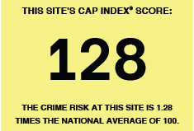
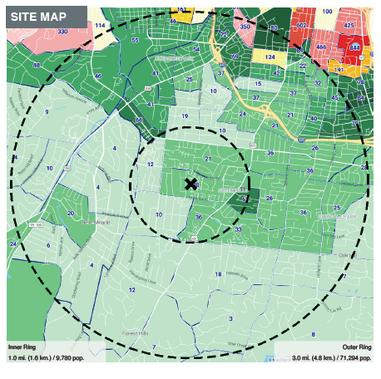
CRIMECAST REPORT FOR ABBOTTSFORD: 3-MILE SITE MAP
This map shows the Crime Risk Scores by census tract. The “X” is 112 Abbottsford.
The inner circle covers a 1-mile radius around 112 Abbottsford. The larger circle covers a 3-mile radius.
The CAP Index Scoring System assigns a numeric risk score and a corresponding risk shading to each tract.
With a score of 38, Abbottsford’s risk of crime is substantially below the National Average, as are each of the census tracts within a 1-mile radius of the neighborhood.
The overwhelming majority of tracts within the 3-mile radius are also well below the National Average.
Based on the 3-mile radius, Abbottsford’s score is 128, meaning it is slightly above the National Average. This is because the three areas shaded yellow and pink bleed into that radius and adversely impact our score.
Within the 3-mile radius, Crimes Against Property are the greatest threat. Averaging the scores for Burglary, Larceny, and Motor Vehicle Theft reveals a CAP Index Score of almost 4x the National Average. Scores for Crimes Against Persons – Homicide, Rape, Robbery, and Aggravated Assault – reveal a score that is consistent with the National Average.

Slide 17
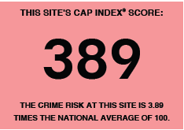
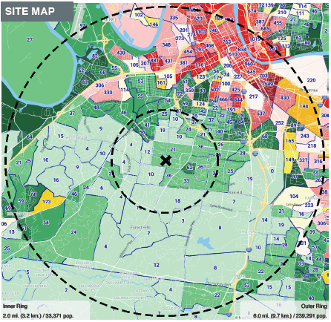
CRIMECAST REPORT FOR ABBOTTSFORD: 6-MILE SITE MAP
Enlarging the 3-mile Site Map to 6 miles reveals the census tracts with greatest risk of crime occurring. They are to the North and Northeast of Abbottsford.
The inner circle covers a 2-mile radius around 112 Abbottsford. The larger circle covers a 6-mile radius.
The red census tracts are potentially where the “journey to crime” that impacts Abbottsford originates.
The red census tracts drive Abbottsford’s CAP Index Score up.
The areas within the 6-mile radius that have the greatest risk of crime occurring are: (1) North of Abbottsford in the census tract at 12:00 to 12:30 position with a Crime Index Score of 1161, or 11.6 times the National Average; (2) Northeast of Abbottsford in the 2:00 position with a score of 1649, or 16.4 times the National Average.
Major surface arteries (Harding Road, Hillsboro Pike) as well as interstates (I-65, I-40, I-440) run through the 6-mile radius and the areas of greatest risk of crime occurring. They likely facilitate ingress to and egress from the 1 mile and 2 mile radius around Abbottsford.
Within the 6-mile radius, as with the 3-mile radius, Crimes Against Property are the greatest threat. Averaging the scores for Burglary, Larceny, and Motor Vehicle Theft reveals a CAP Index Score of 5x the National Average. Averaging scores for Crimes Against Persons – Homicide, Rape, Robbery, and Aggravated Assault – reveals a score that is 3x the National Average.

Slide 18
Abbottsford Security Committee
RECOMMENDATIONS
October 18, 2023

Slide 19
No gate should be installed at the entrance to Abbottsford or guard posted at the entrance*.
The overwhelming number of residents (72%) are comfortable or very comfortable with Abbottsford’s security environment.
The police department’s West Precinct Community Coordination Unit assessed Abbottsford to be a “safe community.”
The police advised that when crime happens at GH Mall, the criminals are not going to head toward Abbottsford. They’re going to go in the opposite direction because they want to get out of the area. Remaining in the immediate vicinity is too risky for them.
There are multiple, less-costly measures to deter crime, including:
Per the police, lighting in all alleys ranges from dark to very dark. Residents can drastically improve this security weakness by illuminating the exterior of their homes. Fixtures can be put on an automatic timer, photocell, or motion sensor. To facilitate these improvements, the Abbottsford Board should identify specific areas of darkness where neighbors can collaborate with one another to deliver enhancements, should inform these neighbors of their observations, and encourage responsive action.
Per police observation, lighting in the common parking areas can be improved to make vehicles parked there less attractive targets.
Homeowners who do not have Ring or other types of cameras on their residences can install them.
Most residences have intrusion alarm system. Residents can stake visible alarm company signage in the front and back yards and make sure to use their alarms.
To strengthen the crime prevention benefit of chain-link fences, dense foliage should be pruned and maintained so it doesn’t provide a hiding place for criminals. Chain-link fences should also be shored-up with “defensive plantings” such as prickly shrubs and hostile hedges.
Make “No Trespassing” signage at the Abbottsford entrance more visible. Such signage gives law enforcement a tool to remove suspicious persons from private property and can help support a conviction on a criminal trespass charge.
Implement a Neighborhood Watch Program to engage Abbottsford residents in crime prevention. To learn about Neighborhood Watch in Nashville, go to: https://www.nashville.gov/departments/police/get-involved/neighborhood-watch. If we are interested in pursuing this, contact the West Precinct Community Coordination Unit to help get the program started.
* If circumstances warrant, eg., police notify the Board of a verified threat in the area around Abbottsford or the Board becomes aware of a threat against a specific resident, then a guard should be posted until such time as the threat has been mitigated.

Slide 20
Although no additional cameras are needed in the common areas, Abbottsford should be vigilant that its existing cameras are functioning and properly maintained and that the system is built on current / upgraded technology to ensure parts continue to be available should maintenance be required.
With regard to the existing cameras, (a) Research the feasibility, pros, and cons of connecting the HOA’s Flock and CCTV cameras to the Real Time Crime Center and determine whether this would be supported by the HOA. (b) Provide information to residents so they can determine whether they want to connect their home cameras to the RTCC. (c) Ensure there is a back-up to the On-Site Property Manager who can view the HOA’s cameras remotely and is educated about what to do should action need to be taken in his/her absence.
Continue the ongoing upgrade of fixtures in the common areas to install replacement bulbs with additional lumens. Regularly, perform routine maintenance on foliage to ensure it does not block the lamps and allows maximum benefit of lighting.
Identify options and costs to improve illumination in common parking areas.
Include on the agenda of the HOA’s Annual and Semi-Annual Meetings an update on crimes in Abbottsford that have been reported to and verified by the police. Implement a system for timely notifying residents of verified criminal activity in Abbottsford.
The Security Committee should engage with the Landscape Committee to remediate overgrown foliage along fence-lines and plant shrubbery that will deter crime. Future landscaping plans should use Crime Prevention Through Environmental Design strategies that help reduce crime and fear of crime, deter offender decisions that precede their criminal acts, and build a sense of community.

